Slide 1

““EARLY DETECTION OF CHRONIC KIDNEY DISEASES”
Under the guidance of
Dr.JUDGI
by
THARUN D
(41111273)

Slide 2
ABSTRACT
CKD is a global health concern demanding early detection.
SVM, a powerful machine learning algorithm, holds promise for early CKD detection.
Research aims to develop an SVM model for CKD detection using diverse clinical and lab data.
Objectives: assess model performance, identify key prediction factors, and integrate SVM into clinical practice.
Results highlight SVM's effectiveness in early CKD detection, with potential to improve healthcare.
Keywords: SVM, Decision Tree, Random Forest and Extreme Gradient boosting algorithms.

Slide 3
INTR0DUTION
CKD global health concern, early detection crucial.
Benefits: prevention, cost-effectiveness, research.
Traditional methods lack sensitivity for early stages.
Progressive approach: data-driven, personalized, predictive models.

Slide 4
OBJECTIVE, SCOPE OF WORK
Early CKD detection
Precise risk assessment
Personalized health practices
Slow CKD progression
Public awareness
Provider training
Technology and data
Ongoing evaluation
Cost reduction
Collaboration
Improved patient outcomes
Research contribution

Slide 5
APPLICATION
Timely intervention
Improved outcomes
Cost reduction
Preventive measures
Personalized treatment
Public health impact
Research data
Healthcare equity
Patient empowerment
Quality improvement

Slide 6
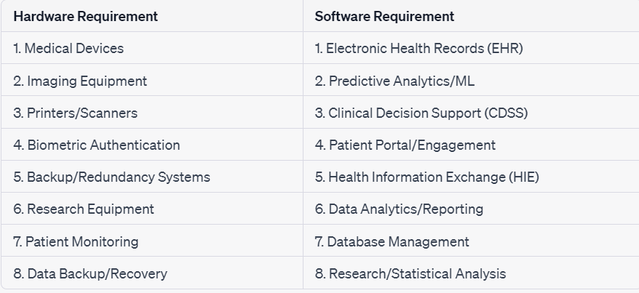
HARDWARE AND SOFTWARE REQUIREMENT

Slide 7
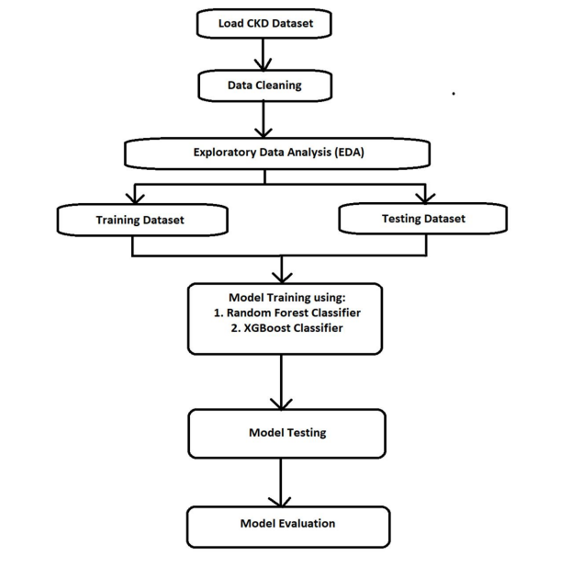
SYSTEM ARCHITECTURE

Slide 8
MODULES
Data Collection
Data Preprocessing
Feature Selection
SVM Model Training
Model Evaluation
User Interface
Integration
Alerts and Reporting
Continuous Monitoring
Telemedicine Integration
Data Security and Privacy
Maintenance and Updates
Education and Training
Research and Development

Slide 9
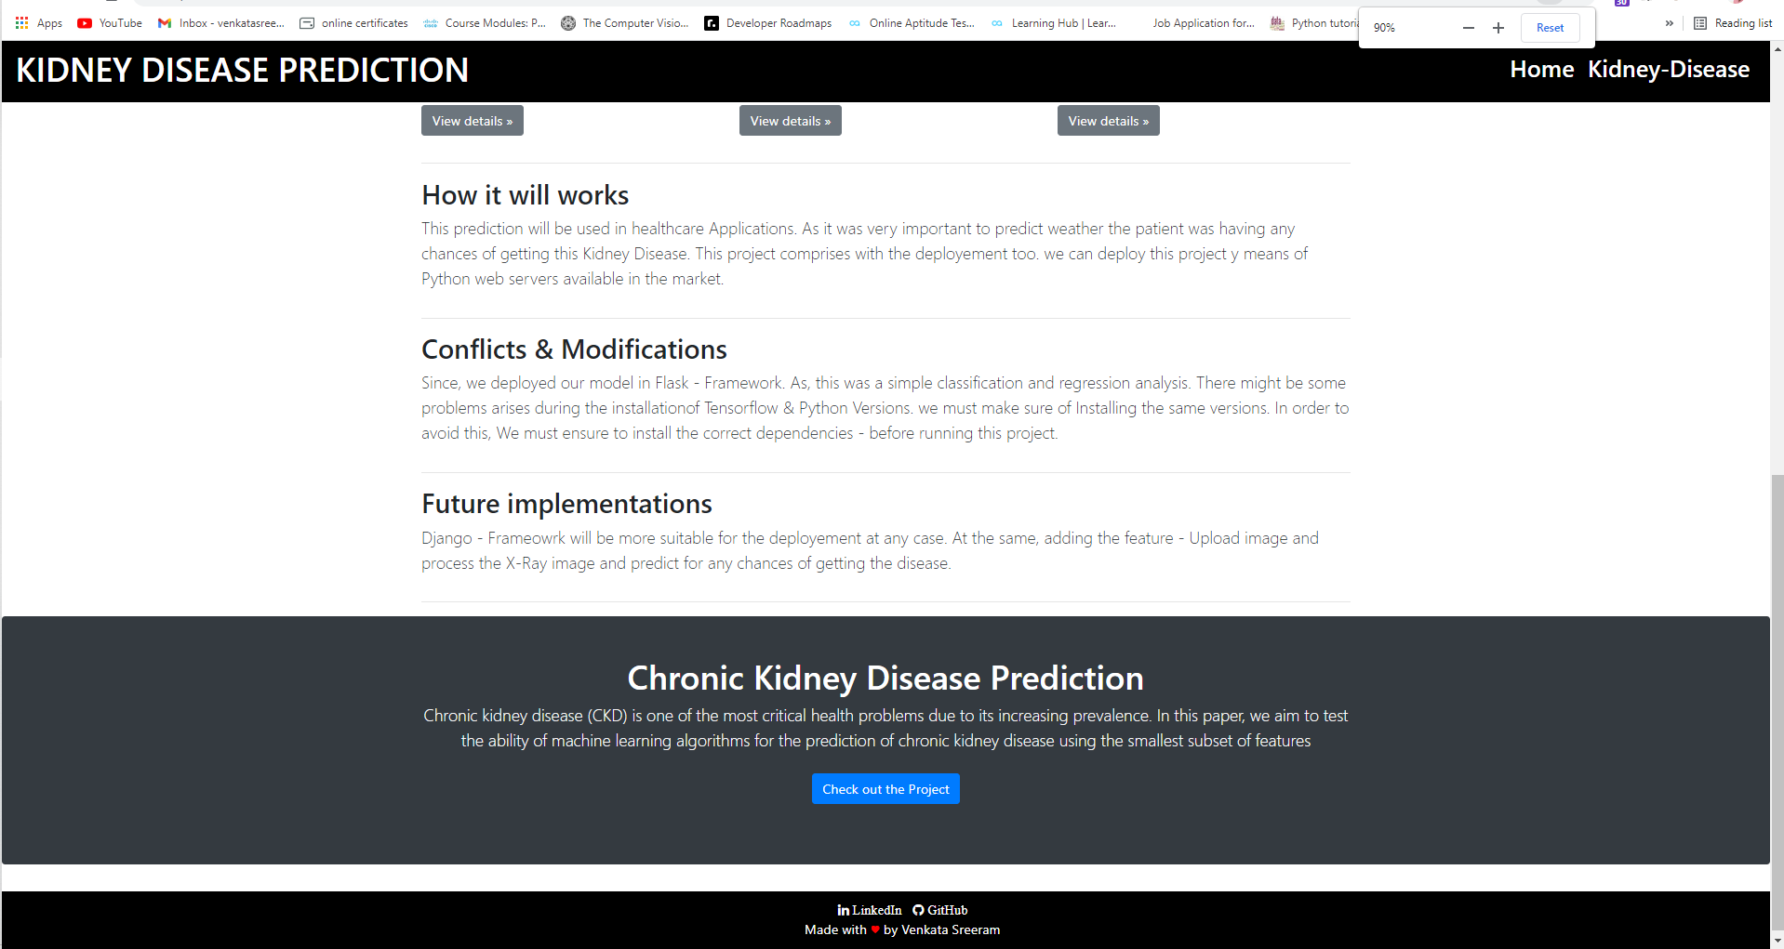
OUTPUT

Slide 10
THANK YOU
We thank our guide and panel and all technical and non technical staff helped us in achieving this.

